Slide 1
Topic08.Unsupervised learning
資料科學 Data Science
張家銘 Jia-Ming Chang
政治大學資訊科學系
The slide isonly for educational purposes. If any infringement, please contact me, we will correct immediately.

Slide 2
Copyright declaration 版權說明
Some of the figures in this presentation are taken from "An Introduction to Statistical Learning, with applications in R" (Springer, 2013) with permission from the authors: G. James, D. Witten, T. Hastie and R. Tibshirani.
The web site of the book
The credit of individual is indicated in the bottom part of the slide.
ie.,

Slide 3
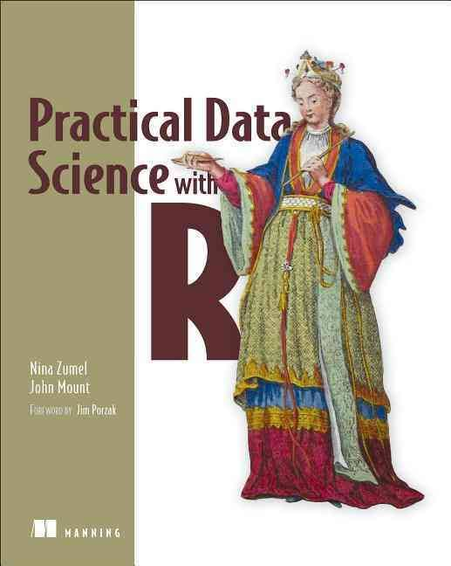
Copyright declaration 版權說明
Some of the figures in this presentation are taken from "Practical Data Science with R (Manning, 2019)”
The web site of the book
The credit of individual is indicated in the bottom part of the slide.
ie.,

Slide 4
Copyright declaration 版權說明
Some of the figures in this presentation are taken from "R for Data Science” under the Creative Commons Attribution-NonCommercial-NoDerivs 3.0 License.
The web site of the book
The credit of individual is indicated in the bottom part.
ie.,

Slide 5
Recap from the last week

Slide 6
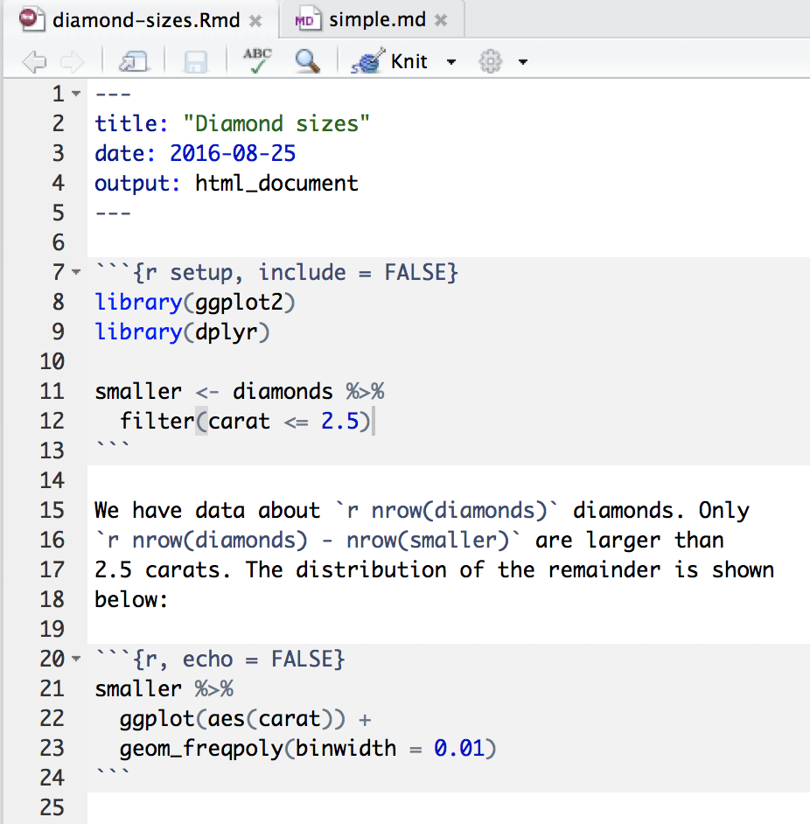
knit the document R Markdown
R for Data Science by Garrett Grolemund, Hadley Wickham

Slide 7
supervised vs. unsupervised learning
supervised learning
Input: a set of p features X₁,X₂, . . .,X_{p}, measured on n observations, and a response Y also measured on those same n observations
Goal: predict Y using X₁,X₂, . . . , X_{p}
unsupervised learning
Input: X₁ ,X₂ , . . . , X_{p} measured on n observations
Output: discover interesting things about the measurements
An Introduction to Statistical Learning with Applications in R by Gareth James, Daniela Witten, Trevor Hastie, Robert Tibshirani

Slide 8
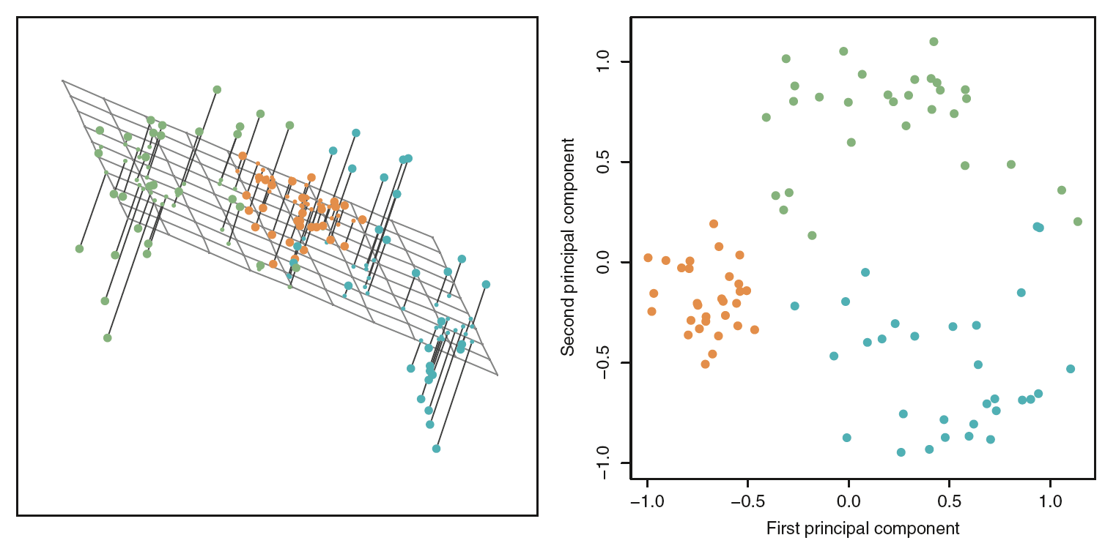
Figure10.2, An Introduction to Statistical Learning with Applications in R by Gareth James, Daniela Witten, Trevor Hastie, Robert Tibshirani

Slide 9
Chp. 8: Unsupervised methods
Chp. 10.3 Clustering Methods

Slide 10
Unsupervised methods
we’ll look at methods to discover unknown relationships in data
two classes of unsupervised methods
Cluster analysis : finds groups in your data with similar characteristics
Hierarchical clustering
k-means
Association rule : mining finds elements or properties in the data that tend to occur together.
Practical Data Science with R by Nina Zumel, John Mount

Slide 11
Clustering analysis
Unsupervised learning

Slide 12
Clustering
Refers to a very broad set of techniques for finding subgroups, or clusters, in a data set
n observations = tissue samples for patients with breast cancer
p features = clinical measurements: tumor stage or grade, or gene expression measurements
a few different unknown subtypes of breast cancer
Clustering looks to find homogeneous subgroups among the observations.
An Introduction to Statistical Learning with Applications in R by Gareth James, Daniela Witten, Trevor Hastie, Robert Tibshirani

Slide 13
Distances
distance.R
Euclidean distance (squared Euclidean distance = L2 distance)
when all the data is real-valued (quantitative)
edist(x,y)<-sqrt((x[1]-y[1])^2+(x[2]-y[2])^2+...)
Hamming distance
categorical variables (male /female , or small /medium /large )
hdist(x,y)<-sum((x[1]!=y[1])+(x[2]!= y[2])+ ...)
Practical Data Science with R by Nina Zumel, John Mount

Slide 14
Distances
Manhattan (city block) distance : L1 distance
# of horizontal and vertical units from one point to the other
mdist(x,y)<-sum(abs(x[1]-y[1])+abs(x[2]-y[2]) +...)
Cosine similarity
dot(x, y)<-sum( x[1]*y[1] + x[2]*y[2] + ... )
cossim(x, y)<-dot(x, y)/(sqrt(dot(x,x)*dot(y,y)))
1 - 2*acos(cossim(x,y))/pi
Practical Data Science with R by Nina Zumel, John Mount

Slide 15
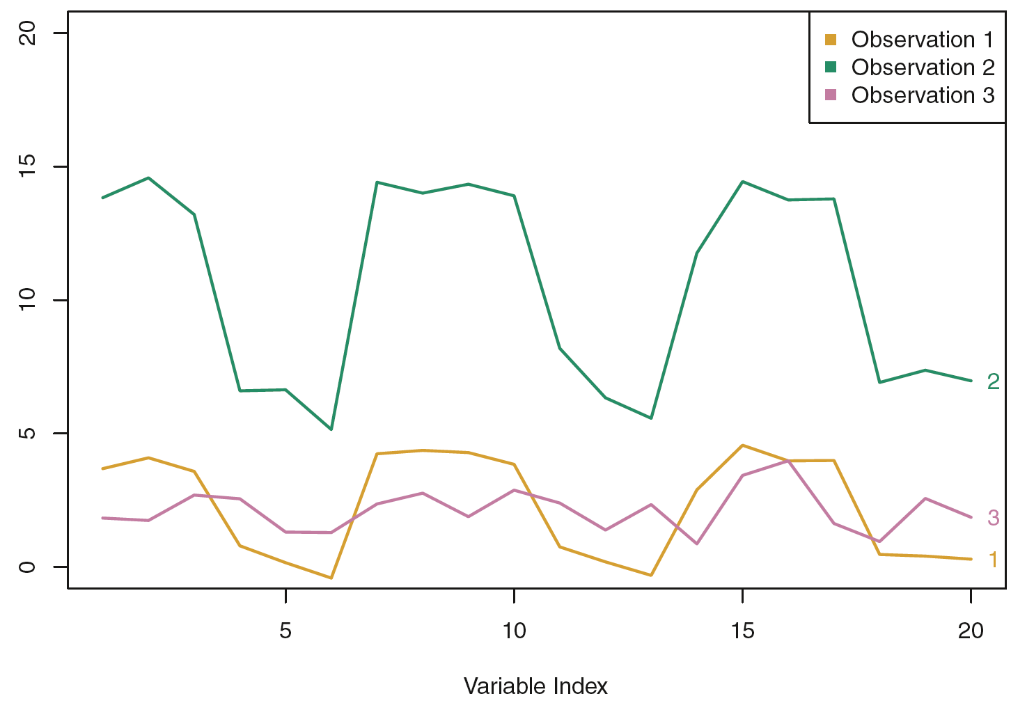
Euclidean distance vs. correlation-based distance
Figure10.13, An Introduction to Statistical Learning with Applications in R by Gareth James, Daniela Witten, Trevor Hastie, Robert Tibshirani

Slide 16
clustering approaches
K-means clustering
we seek to partition the observations into a pre-specified number of clusters.
Hierarchical clustering
we do not know in advance how many clusters we want; in fact, we end up with a tree-like visual representation of the observations, dendrogram
allows us to view at once the clusterings obtained for each possible number of clusters, from 1 to n.
An Introduction to Statistical Learning with Applications in R by Gareth James, Daniela Witten, Trevor Hastie, Robert Tibshirani

Slide 17
Prepare data
a small dataset from 1973 on protein consumption from nine different food groups in 25 countries in Europe => group the countries based on patterns in their protein consumption.
protein/protein.R
protein <- read.table("protein.txt", sep="\t", header=TRUE)
Practical Data Science with R by Nina Zumel, John Moun

Slide 18
Prepare data
What should you do first?
vars.to.use <- colnames(protein)[-1]
pmatrix <- scale(protein[,vars.to.use])
pcenter <- attr(pmatrix, "scaled:center")
pscale <- attr(pmatrix, "scaled:scale")
Practical Data Science with R by Nina Zumel, John Moun

Slide 19
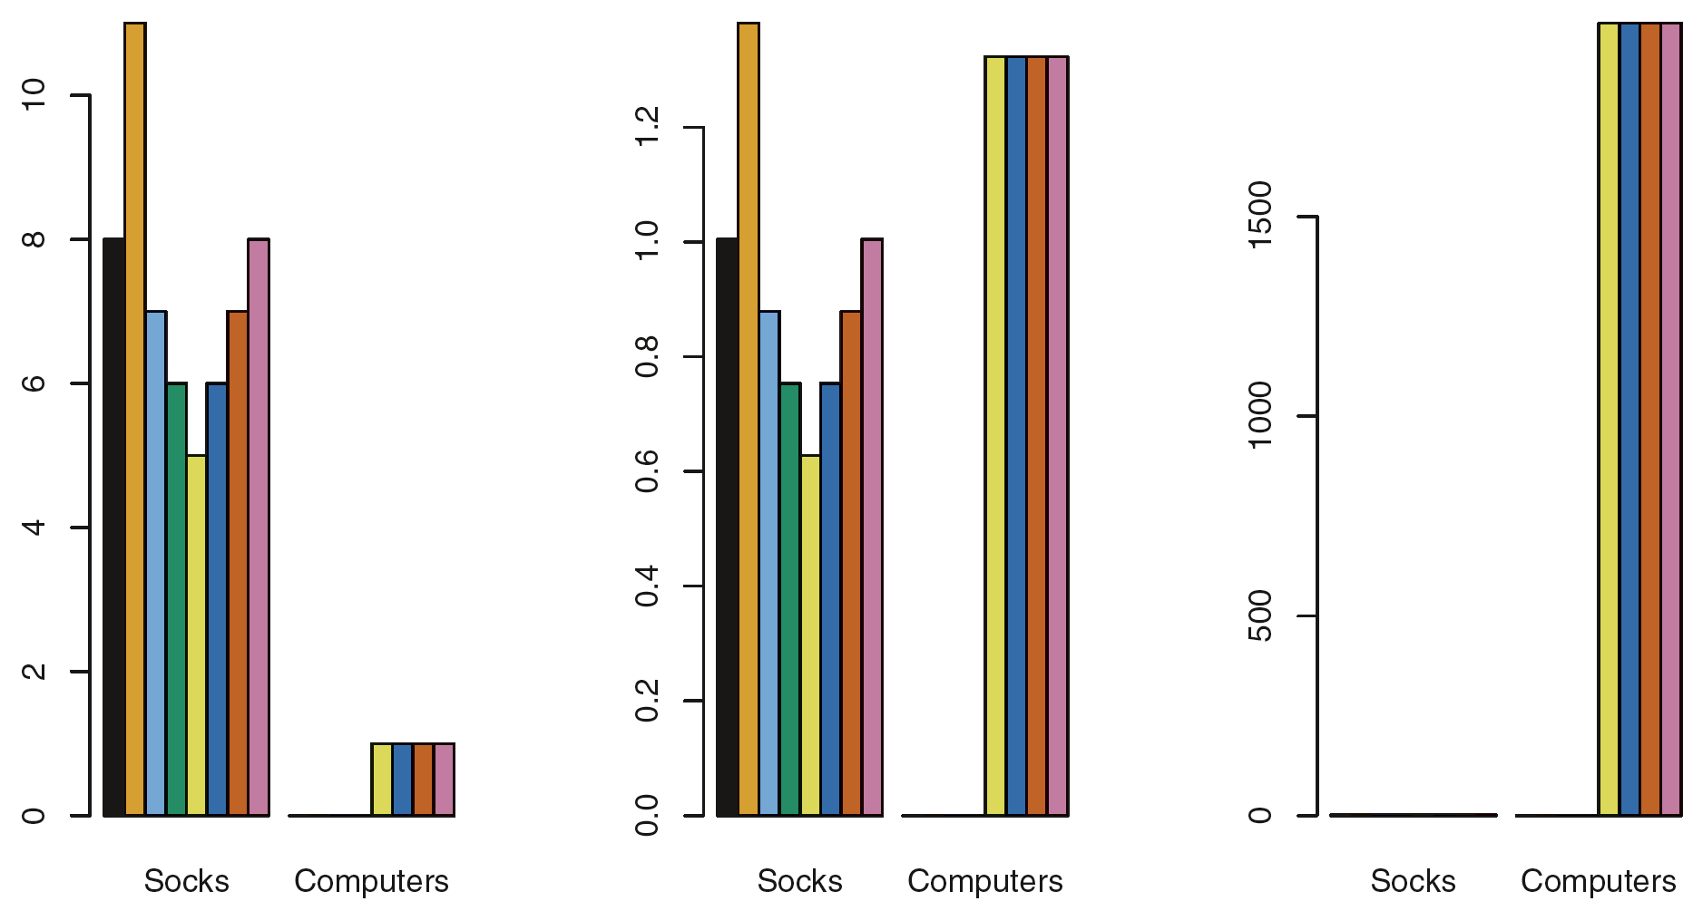
To Scale or not to scale
Figure10.14, An Introduction to Statistical Learning with Applications in R by Gareth James, Daniela Witten, Trevor Hastie, Robert Tibshirani

Slide 20
Hierarchical clustering
Unsupervised learning
Clustering analysis

Slide 21
Hierarchical clustering
an alternative approach which does not require that we commit to a particular choice of K
results in an attractive tree-based representation of the observations, called a dendrogram
An Introduction to Statistical Learning with Applications in R by Gareth James, Daniela Witten, Trevor Hastie, Robert Tibshirani

Slide 22
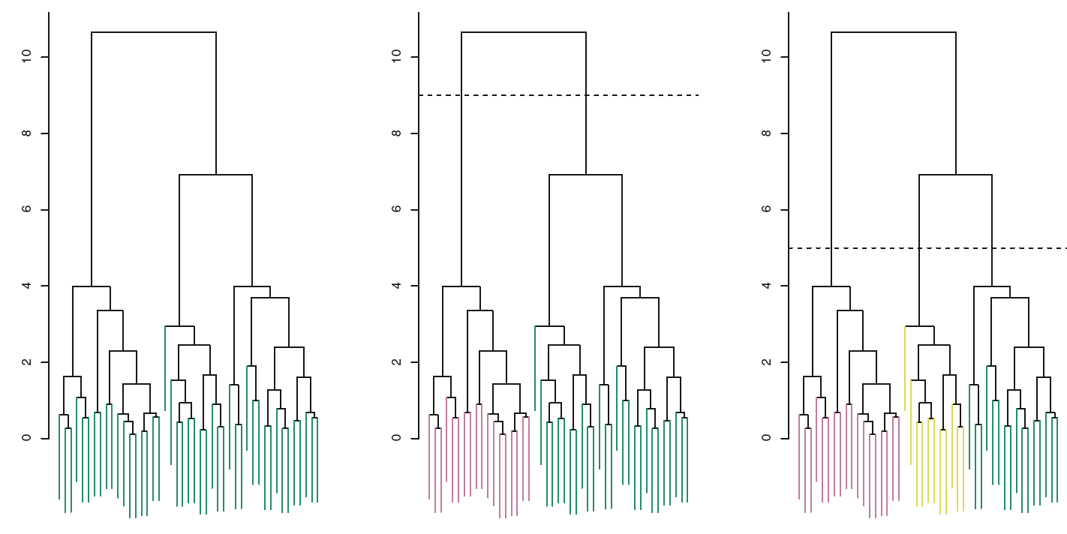
Interpreting a Dendrogram
the vertical axis, indicates how different the two observations are.
c
b
a
Figure10.9, An Introduction to Statistical Learning with Applications in R by Gareth James, Daniela Witten, Trevor Hastie, Robert Tibshirani

Slide 23
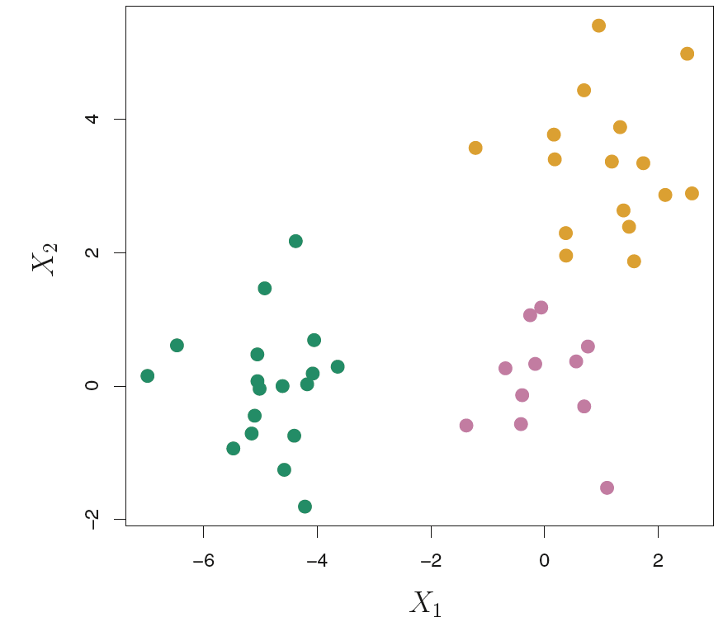
Forty-five observations generated in two-dimensional space
Figure10.8, An Introduction to Statistical Learning with Applications in R by Gareth James, Daniela Witten, Trevor Hastie, Robert Tibshirani

Slide 24
Interpreting a Dendrogram
the similarity of two observations based
on the location on the vertical axis where branches containing those two observations first are fused.
on their proximity along the horizontal axis the similarity of two observations based
An Introduction to Statistical Learning with Applications in R by Gareth James, Daniela Witten, Trevor Hastie, Robert Tibshirani

Slide 25
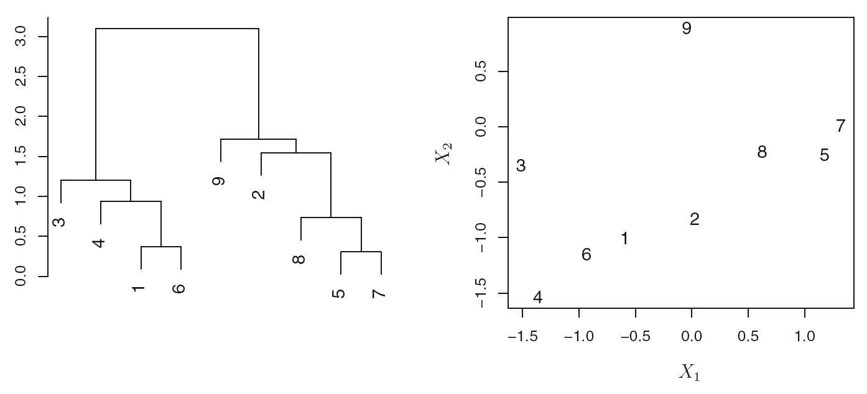
Interpreting a Dendrogram
Figure10.10, An Introduction to Statistical Learning with Applications in R by Gareth James, Daniela Witten, Trevor Hastie, Robert Tibshirani

Slide 26
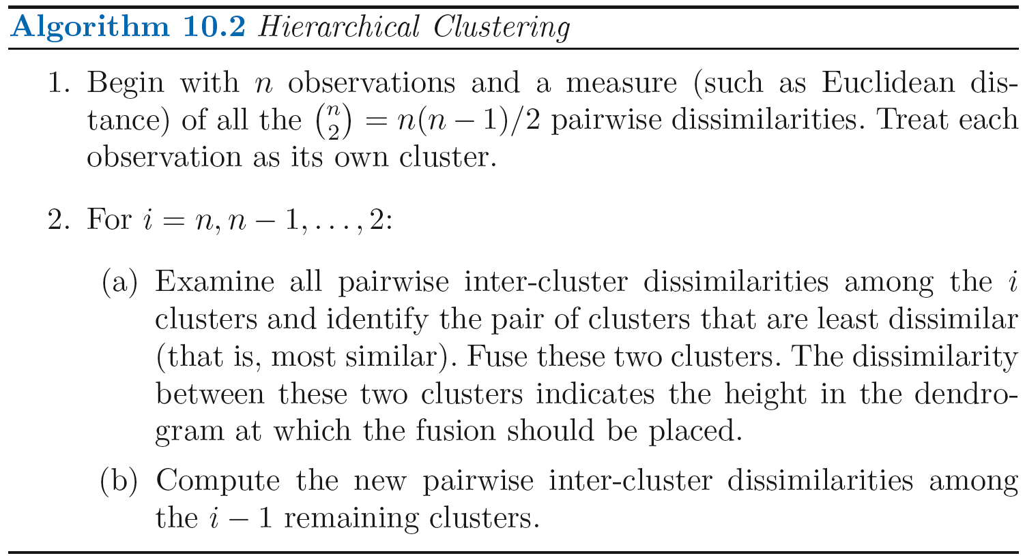
An Introduction to Statistical Learning with Applications in R by Gareth James, Daniela Witten, Trevor Hastie, Robert Tibshirani

Slide 27
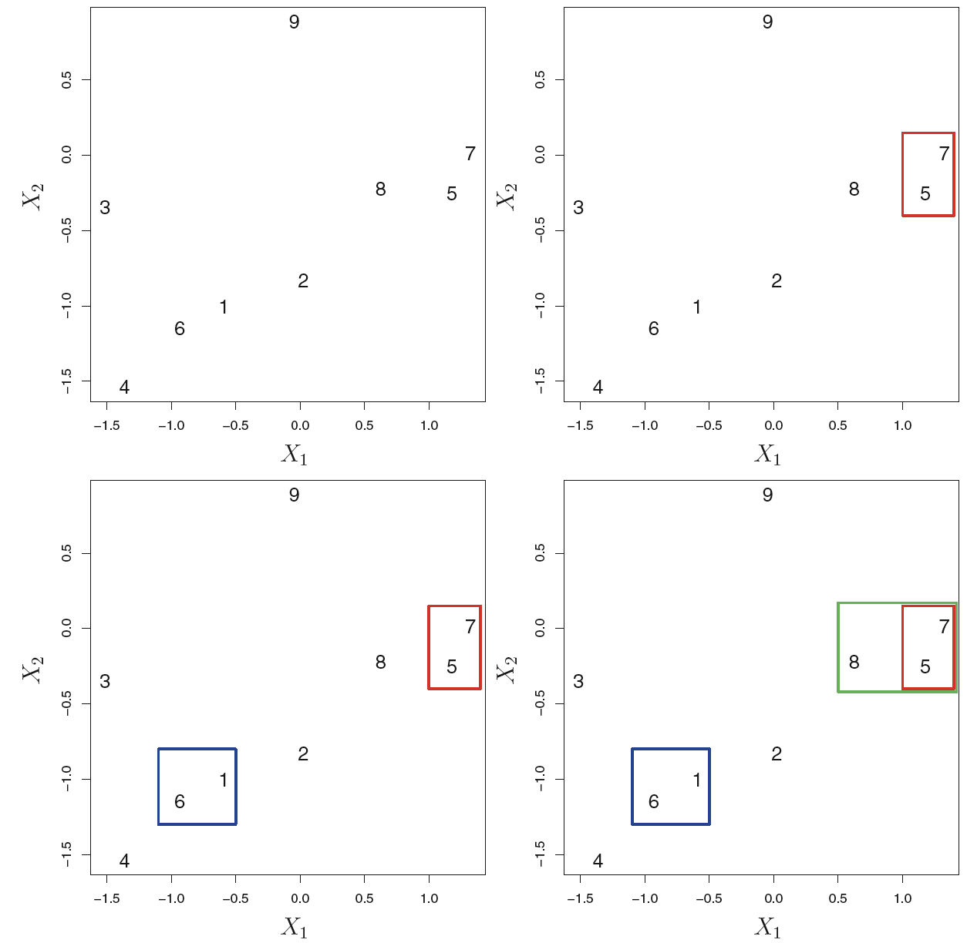
Figure10.11, An Introduction to Statistical Learning with Applications in R by Gareth James, Daniela Witten, Trevor Hastie, Robert Tibshirani

Slide 28
Linkage
dissimilarity between two groups of observations

Slide 29
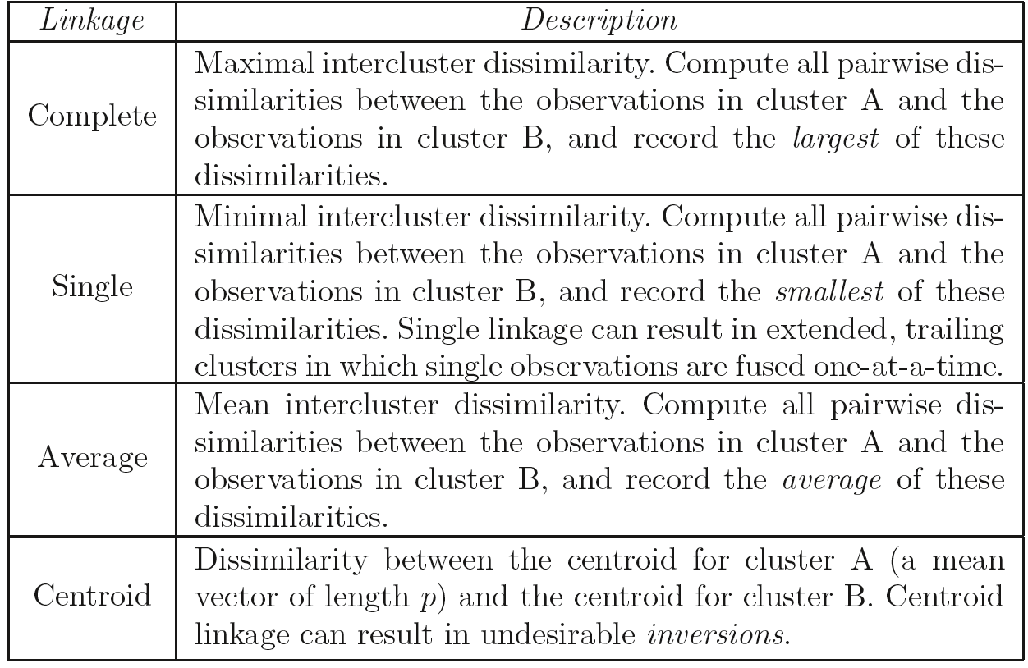
An Introduction to Statistical Learning with Applications in R by Gareth James, Daniela Witten, Trevor Hastie, Robert Tibshirani

Slide 30
Linkage comparison
Average, complete, and single linkage are most popular among statisticians.
Average and complete linkage are generally preferred over single linkage, as they tend to yield more balanced dendrograms.
An Introduction to Statistical Learning with Applications in R by Gareth James, Daniela Witten, Trevor Hastie, Robert Tibshirani

Slide 31
Linkage comparison
Centroid linkage is often used in genomics
drawback : an inversion can occur, whereby inversion two clusters are fused at a height below either of the individual clusters in the dendrogram
Credit by https://nlp.stanford.edu/IR-book/html/htmledition/centroid-clustering-1.html

Slide 32
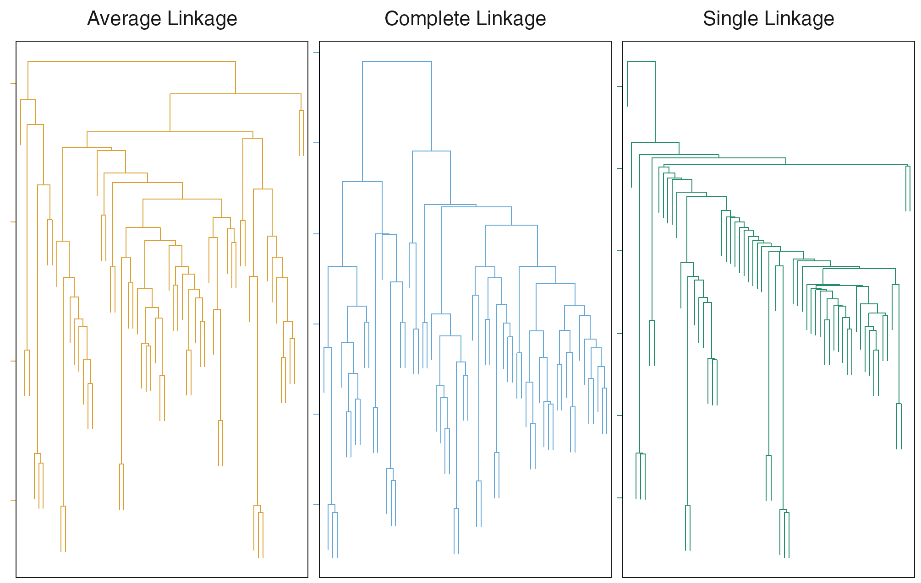
Figure10.12, An Introduction to Statistical Learning with Applications in R by Gareth James, Daniela Witten, Trevor Hastie, Robert Tibshirani

Slide 33
Hierarchical clustering
d <- dist(pmatrix, method="euclidean")
pfit <- hclust(d,method="complete")
plot(pfit, labels=protein$Country)
Practical Data Science with R by Nina Zumel, John Mount

Slide 34
Hierarchical clustering
The dendrogram suggests five clusters = > draw the rectangles on the dendrogram
rect.hclust(pfit, k=5)
Practical Data Science with R by Nina Zumel, John Mount

Slide 35
Hierarchical clustering
Extracting the clusters found by hclust
groups <- cutree(pfit, k=5)
print_clusters <- function(labels, k) {
for(i in 1:k) {
print(paste("cluster", i))
print(protein[labels==i,c("Country","RedMeat","Fish","Fr.Veg")])
}
}
print_clusters(groups, 5)
Practical Data Science with R by Nina Zumel, John Mount

Slide 36
Visualizing clusters by PCA
library(ggplot2)
princ <- prcomp(pmatrix)
nComp <- 4
project <- predict(princ, newdata=pmatrix)[,1:nComp]
Practical Data Science with R by Nina Zumel, John Mount

Slide 37
Visualizing clusters by PCA
project.plus <- cbind(as.data.frame(project),
cluster=as.factor(groups),
country=protein$Country)
ggplot(project.plus, aes(x=PC3, y=PC4)) +
geom_point(aes(shape=cluster)) +
geom_text(aes(label=country),
hjust=0, vjust=1)
Practical Data Science with R by Nina Zumel, John Mount

Slide 38
Complete Linkage with Correlation-Based Distance
x=matrix (rnorm (30*3) , ncol =3)
dd=as.dist(1- cor(t(x)))
plot(hclust (dd, method ="complete"), xlab="", sub ="")
An Introduction to Statistical Learning with Applications in R, by Gareth James, Daniela Witten, Trevor Hastie, Robert Tibshirani

Slide 39
k-means
Unsupervised learning
Clustering analysis

Slide 40
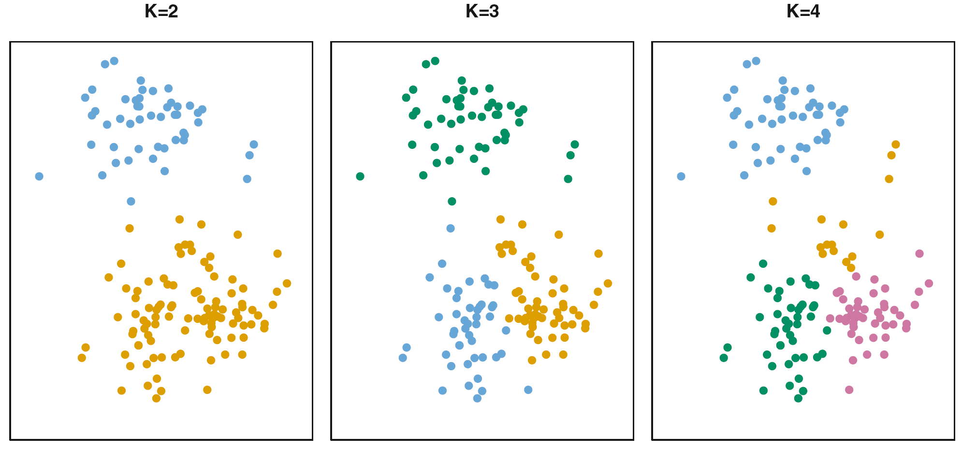
K-means clustering
a simple and elegant approach for partitioning a data set into K distinct, non-overlapping clusters
Figure10.5, An Introduction to Statistical Learning with Applications in R by Gareth James, Daniela Witten, Trevor Hastie, Robert Tibshirani

Slide 41
K-means clustering
Let C₁, . . ., C_{K} denote sets containing the indices of the observations in each cluster.
C₁ ∪ C₂ ∪ . . . ∪ C_{K} = {1 , . . ., n}.
C_{i} ∩ C_{j} = ∅ for all i != j.
An Introduction to Statistical Learning with Applications in R by Gareth James, Daniela Witten, Trevor Hastie, Robert Tibshirani

Slide 42
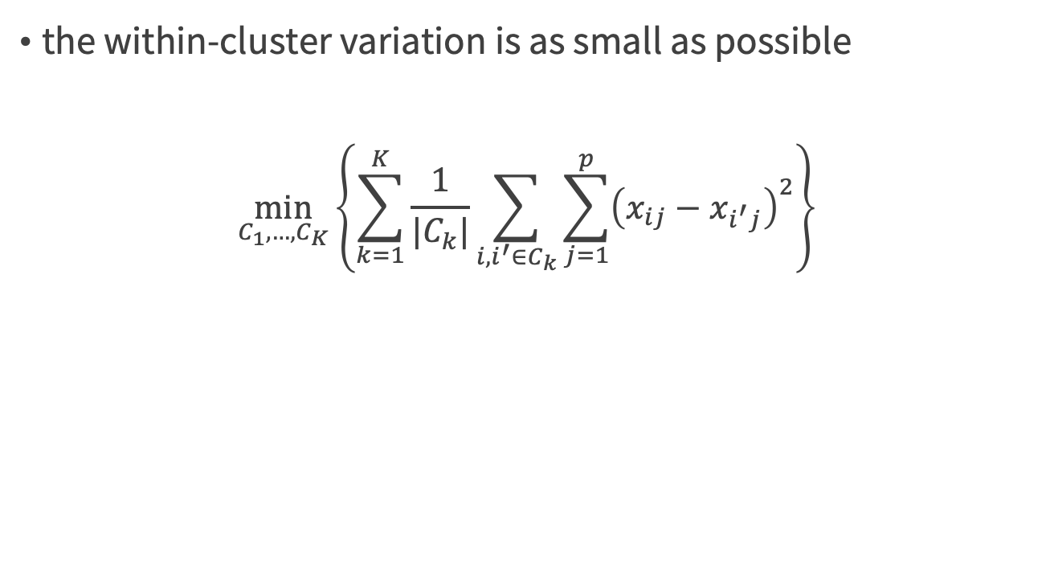
Good clustering
the within-cluster variation is as small as possible
$$\min_{C_{1},…,C_{K}}\left\{\sum_{k=1}^{K}{\frac{1}{|C_{k}|}\sum_{i,i^{′}∈C_{k}}{\sum_{j=1}^{p}{{\left(x_{ij}−x_{i^{′}j}\right)}^{2}}}}\right\}$$
An Introduction to Statistical Learning with Applications in R by Gareth James, Daniela Witten, Trevor Hastie, Robert Tibshirani

Slide 43
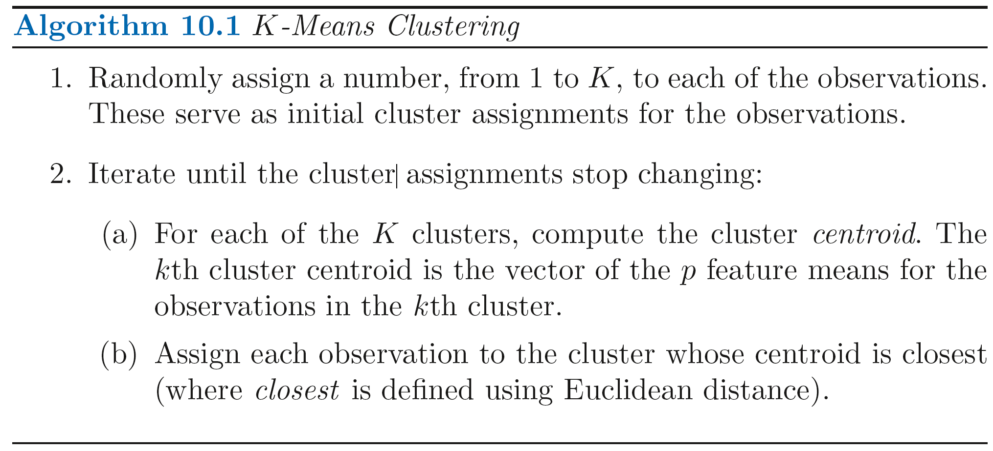
An Introduction to Statistical Learning with Applications in R by Gareth James, Daniela Witten, Trevor Hastie, Robert Tibshirani

Slide 44
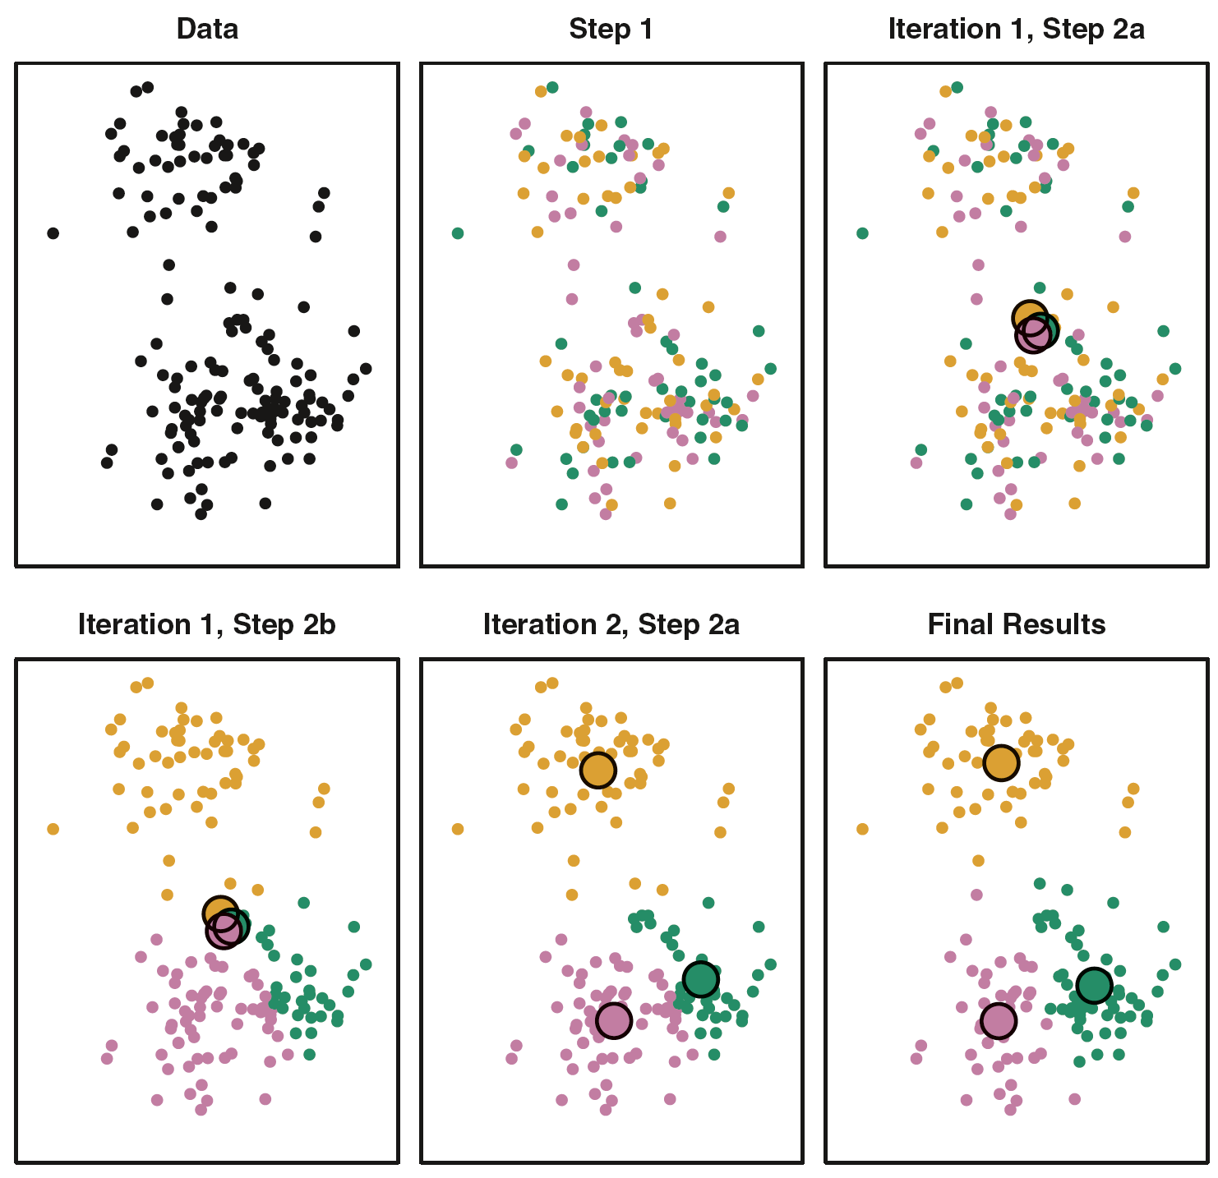
The progress of the K-means algorithm
Figure10.6, An Introduction to Statistical Learning with Applications in R by Gareth James, Daniela Witten, Trevor Hastie, Robert Tibshirani

Slide 45
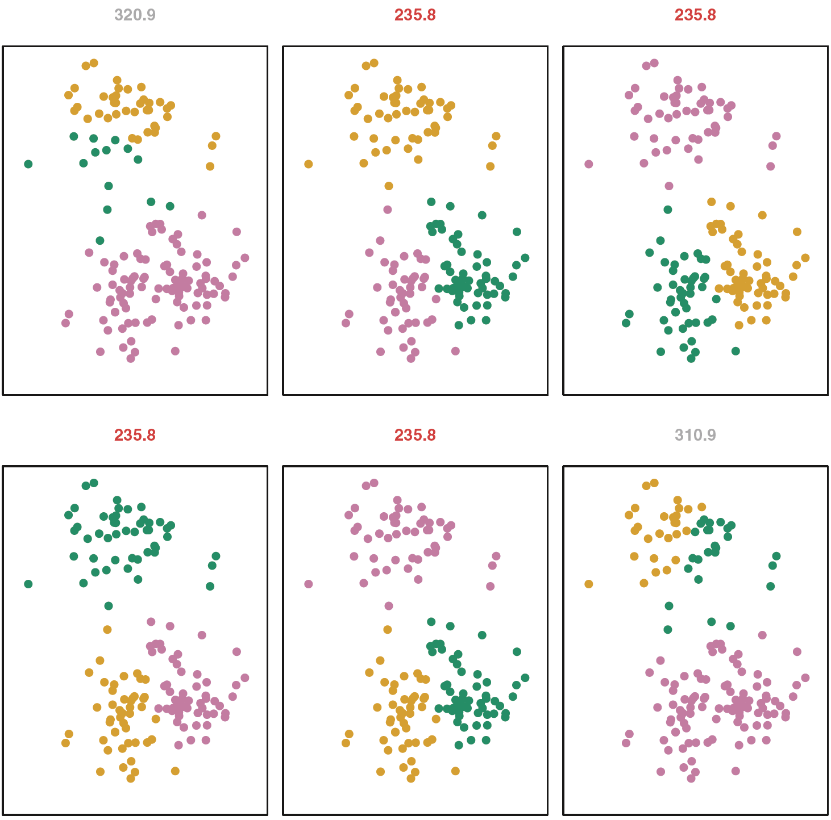
K-means clustering performed 6 times
Figure10.7, An Introduction to Statistical Learning with Applications in R by Gareth James, Daniela Witten, Trevor Hastie, Robert Tibshirani

Slide 46
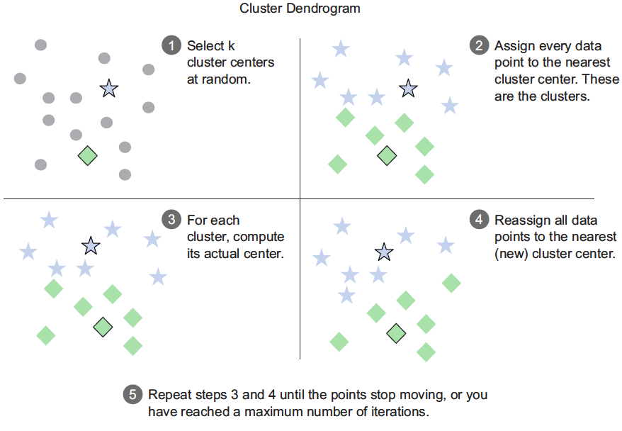
The k-means procedure
Figure8.6, Practical Data Science with R by Nina Zumel, John Mount

Slide 47
Running k-means with k = 5
library(fpc)
kbest.p<-5
pclusters <- kmeans(pmatrix, kbest.p, nstart=100, iter.max=100)
pclusters
pclusters$centers
pclusters$size
groups <- pclusters$cluster
print_clusters(groups, kbest.p)
Practical Data Science with R by Nina Zumel, John Mount

Slide 48
nstart
pclusters <- kmeans(pmatrix, kbest.p, nstart=100, iter.max=100)
pclusters$tot.withinss
pclusters <- kmeans(pmatrix, kbest.p, nstart=1, iter.max=100)
pclusters$tot.withinss
Practical Data Science with R by Nina Zumel, John Mount

Slide 49
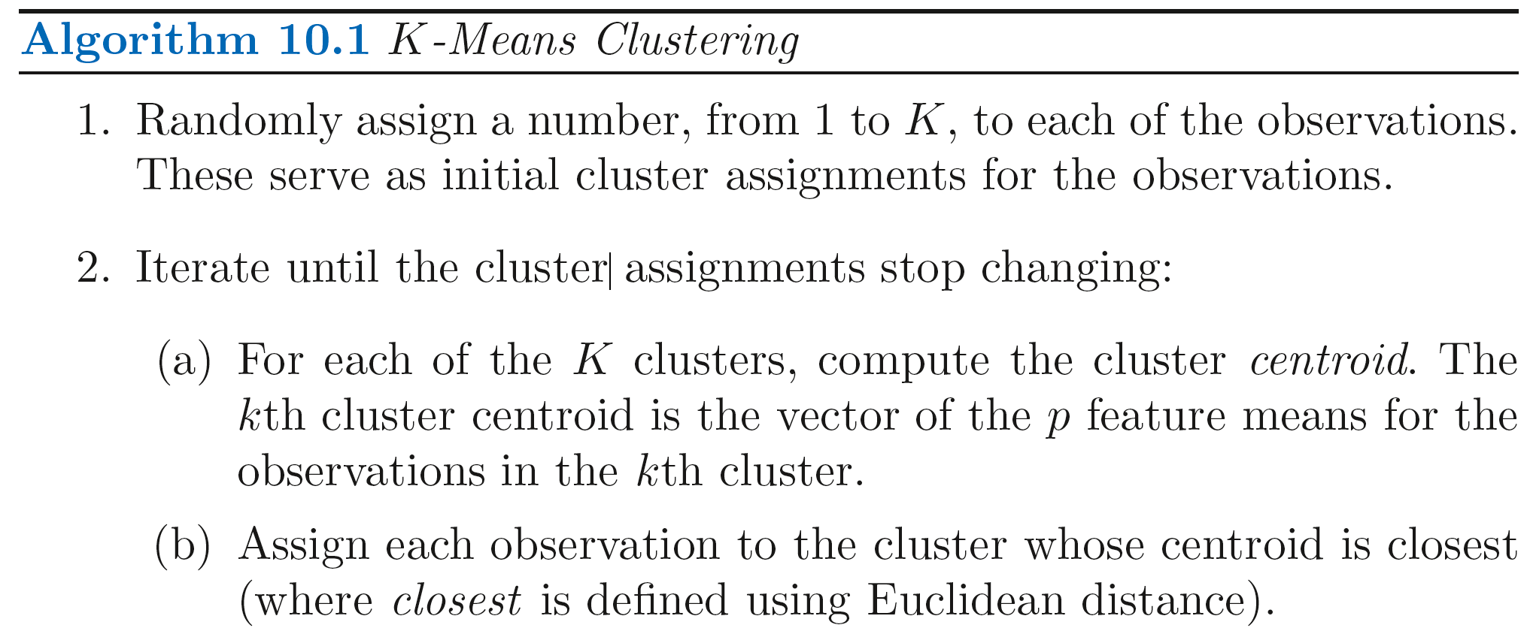
nstart > 1
K-means clustering will be performed using multiple random assignments in Step 1 of Algorithm 10.1
the kmeans() function will report only the best results.
Recommend: 20 or 50
An Introduction to Statistical Learning with Applications in R by Gareth James, Daniela Witten, Trevor Hastie, Robert Tibshirani

Slide 50
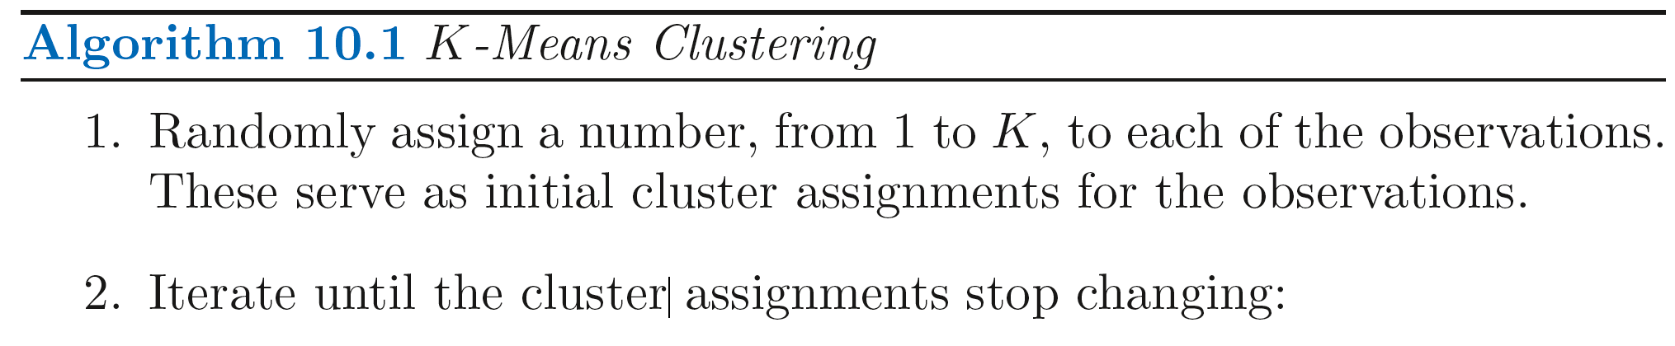
set.seed()
set.seed(3)
pclusters <- kmeans(pmatrix, kbest.p, nstart=5, iter.max=100)
pclusters$tot.withinss
the initial cluster assignments in Step 1 can be replicated
=> the K-means output will be fully reproducible
An Introduction to Statistical Learning with Applications in R by Gareth James, Daniela Witten, Trevor Hastie, Robert Tibshirani

Slide 51
The k-means algorithm
the data is all numeric and the distance metric is squared Euclidean (though you could in theory run it with other distance metrics)
Plus side
easy to implement
can be faster than hierarchical clustering on large datasets
works best on data that looks like a mixture of Gaussians
Practical Data Science with R by Nina Zumel, John Mount

Slide 52
The k-means algorithm
Negative side
must pick k in advance
fairly unstable
the final clusters depend on the initial cluster centers.
This algorithm isn’t guaranteed to have a unique stopping point.
Practical Data Science with R by Nina Zumel, John Mount

Slide 53
How many clusters should we look for in the data?

Slide 54
Picking the number of clusters
total Within Sum of Squares (WSS)
centroid : the mean value of all the points in the cluster
sum of squares for a single cluster : the average squared distance of each point in the cluster from the cluster’s centroid.
sum of the within sum of squares of all the clusters
Practical Data Science with R by Nina Zumel, John Mount

Slide 55
Calculating WSS – WSS.R
sqr_edist <- function(x, y) {
sum((x-y)^2)
}
wss.cluster <- function(clustermat) {
c0 <- apply(clustermat, 2, FUN=mean)
sum(apply(clustermat, 1, FUN=function(row){sqr_edist(row,c0)}))
}
wss.total <- function(dmatrix, labels) {
wsstot <- 0
k <- length(unique(labels))
for(i in 1:k)
wsstot <- wsstot + wss.cluster(subset(dmatrix, labels==i))
wsstot
}
Practical Data Science with R by Nina Zumel, John Mount

Slide 56
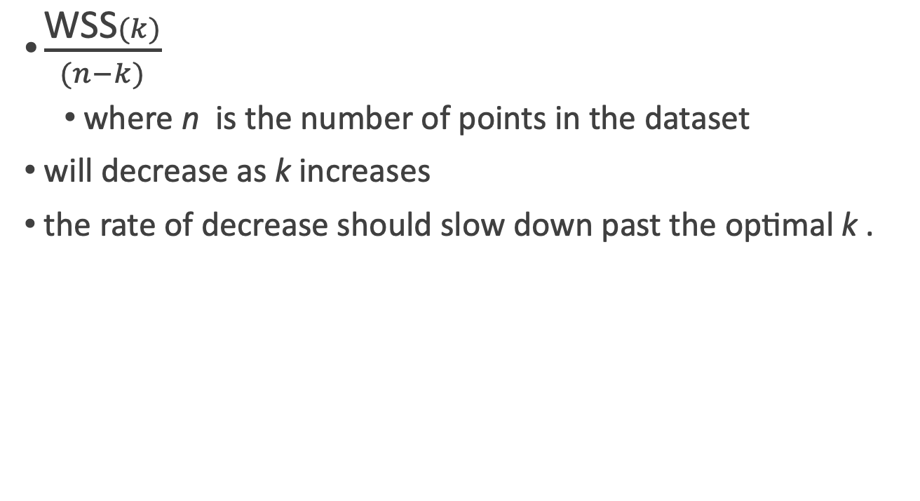
the within-cluster variance, W
$\frac{\text{WSS}(k)}{(n−k)}$
where n is the number of points in the dataset
will decrease as k increases
the rate of decrease should slow down past the optimal k .
Practical Data Science with R by Nina Zumel, John Mount

Slide 57
Total Sum of Squares (TSS)
the squared distance of all the data points from the dataset’s centroid
totss <- function(dmatrix) {
grandmean <- apply(dmatrix, 2, FUN=mean)
sum(apply(dmatrix, 1, FUN=function(row){sqr_edist(row, grandmean)}))
}
Practical Data Science with R by Nina Zumel, John Mount

Slide 58
Between Sum of Squares BSS(k)
Between Sum of Squares BSS(k) of the clustering
BSS(k) = TSS - WSS(k)
The between-cluster variance, B
BSS(k)/(k-1)
will increase as k
the rate of increase should slow down past the optimal k
Practical Data Science with R by Nina Zumel, John Mount

Slide 59
Calinski-Harabasz index
B / W : should be maximized at the optimal k
B = BSS(k)/(k-1)
W = WSS(k)/(n-k)
the between-cluster variance (which is essentially the variance of all the cluster centroids from the dataset’s grand centroid) / the total within-cluster variance (the average WSS of the clusters in the clustering)
Practical Data Science with R by Nina Zumel, John Mount

Slide 60
The Calinski-Harabasz index - CH.R
ch_criterion <- function(dmatrix, kmax, method="kmeans") {
if(!(method %in% c("kmeans", "hclust"))) {
stop("method must be one of c('kmeans', 'hclust')")
}
npts <- dim(dmatrix)[1] # number of rows.
totss <- totss(dmatrix)
wss <- numeric(kmax)
crit <- numeric(kmax)
wss[1] <- (npts-1)*sum(apply(dmatrix, 2, var))
for(k in 2:kmax) {
if(method=="kmeans") {
clustering<-kmeans(dmatrix, k, nstart=10, iter.max=100)
wss[k] <- clustering$tot.withinss
}else { # hclust
d <- dist(dmatrix, method="euclidean")
pfit <- hclust(d, method="ward")
labels <- cutree(pfit, k=k)
wss[k] <- wss.total(dmatrix, labels)
}
}
bss <- totss - wss
crit.num <- bss/(0:(kmax-1))
crit.denom <- wss/(npts - 1:kmax)
list(crit = crit.num/crit.denom, wss = wss, totss = totss)
}
Practical Data Science with R by Nina Zumel, John Mount

Slide 61
Evaluating clusterings with different numbers of clusters
library(reshape2)
source("../CH.R")
source("../WSS.R")
clustcrit <- ch_criterion(pmatrix, 10, method="hclust")
critframe <- data.frame(k=1:10, ch=scale(clustcrit$crit), wss=scale(clustcrit$wss))
critframe <- melt(critframe, id.vars=c("k"), variable.name="measure", value.name="score")
ggplot(critframe, aes(x=k, y=score, color=measure)) +
geom_point(aes(shape=measure)) + geom_line(aes(linetype=measure)) +
scale_x_continuous(breaks=1:10, labels=1:10)
Practical Data Science with R by Nina Zumel, John Mount

Slide 62
the KMEANSRUNS function for picking K
clustering.ch <- kmeansruns(pmatrix, krange=1:10, criterion="ch")
clustering.ch$bestk
clustering.ch$crit
critframe <- data.frame(k=1:10, ch=scale(clustering.ch$crit),
asw=scale(clustering.asw$crit))
critframe <- melt(critframe, id.vars=c("k"), variable.name="measure", value.name="score")
ggplot(critframe, aes(x=k, y=score, color=measure)) +geom_point(aes(shape=measure)) + geom_line(aes(linetype=measure)) + scale_x_continuous(breaks=1:10, labels=1:10)
Practical Data Science with R by Nina Zumel, John Mount

Slide 63
Assigning new points to clusters
assign.R
assign_cluster <- function(newpt, centers, xcenter=0, xscale=1) {
xpt <- (newpt - xcenter)/xscale
dists <- apply(centers, 1, FUN=function(c0){sqr_edist(c0, xpt)})
which.min(dists)
}
Practical Data Science with R by Nina Zumel, John Mount

Slide 64
Whether a given cluster is real?

Slide 65
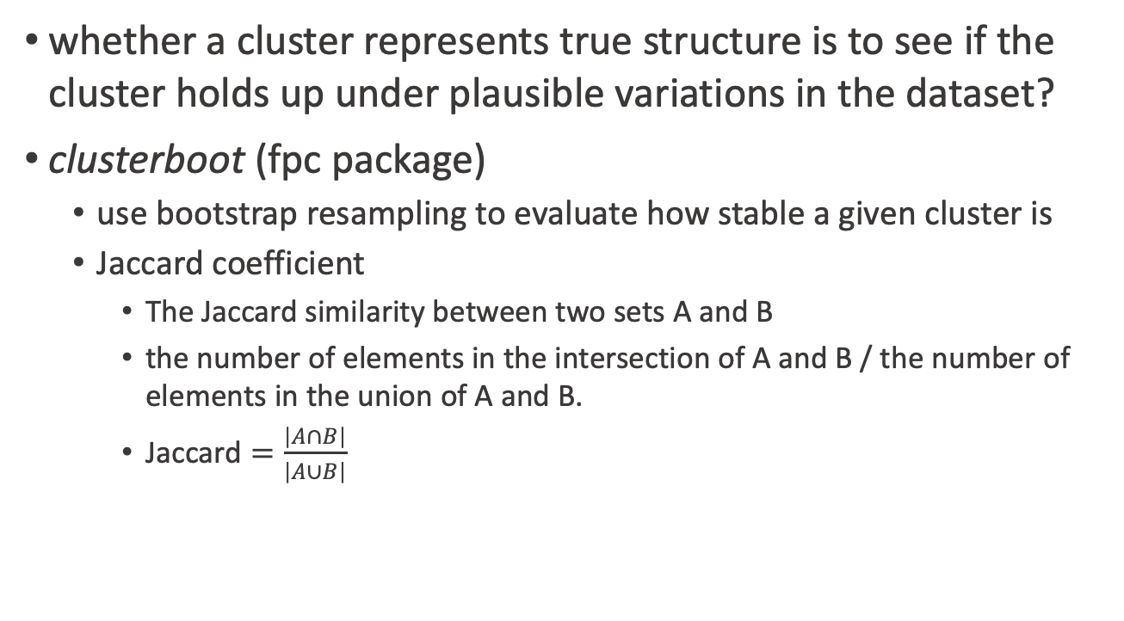
Jaccard coefficient
whether a cluster represents true structure is to see if the cluster holds up under plausible variations in the dataset?
clusterboot (fpc package)
use bootstrap resampling to evaluate how stable a given cluster is
Jaccard coefficient
The Jaccard similarity between two sets A and B
the number of elements in the intersection of A and B / the number of elements in the union of A and B.
$\text{Jaccard}=\frac{\left|A∩B\right|}{\left|A∪B\right|}$
Practical Data Science with R by Nina Zumel, John Mount

Slide 66
Basic general strategy
Cluster the data as usual
Bootstrap
Draw a new dataset (of the same size as the original) by resampling the original dataset with replacement
some of the data points may show up more than once, and others not at all
Cluster the new dataset
For every cluster in the original clustering, find the most similar cluster in the new clustering (the one that gives the maximum Jaccard coefficient) and record that value
If this maximum Jaccard coefficient is less than 0.5, the original cluster is considered to be dissolved.
Repeat Bootstrap several times
Practical Data Science with R by Nina Zumel, John Mount

Slide 67
cluster stability by Jaccard coefficient
The cluster stability of each cluster in the original clustering
the mean value of its Jaccard coefficient over all the bootstrap iterations.
stability value
0.6 <= : unstable.
0.6 ~ 0.75 : measure a pattern in the data, but there isn’t high certainty about which points should be clustered together.
0.85 >= : highly stable (they’re likely to be real clusters).
Practical Data Science with R by Nina Zumel, John Mount

Slide 68
clusterboot with heretical clustering
library(“fpc”)
cboot.hclust <- clusterboot(pmatrix,clustermethod=hclustCBI,method="ward.D", k=kbest.p)
summary(cboot.hclust$result)
groups<-cboot.hclust$result$partition
print_clusters(groups, kbest.p)
cboot.hclust$bootmean
cboot.hclust$bootbrd
Practical Data Science with R by Nina Zumel, John Mount

Slide 69
clusterboot with k-means
cboot<-clusterboot(pmatrix, clustermethod=kmeansCBI, runs=100,iter.max=100, krange=kbest.p, seed=15555)
groups <- cboot$result$partition
print_clusters(cboot$result$partition, kbest.p)
cboot$bootmean
cboot$bootbrd
Practical Data Science with R by Nina Zumel, John Mount

Slide 70
Clustering takeaway

Slide 71
Practical issue
What dissimilarity measure should be used?
What type of linkage should be used?
Where should we cut the dendrogramin order to obtain clusters?
An Introduction to Statistical Learning with Applications in R by Gareth James, Daniela Witten, Trevor Hastie, Robert Tibshirani

Slide 72
Hierarchical vs K-means
hierarchical : clusters are necessarily nested within the clusters obtained by cutting the dendrogram at any greater height
hierarchical clustering can sometimes yield worse (i.e. less accurate) results than K-means clustering for a given number of clusters

Slide 73
Hierarchical vs K-means
our observations correspond to a group of people
with a 50–50 split of males and females
evenly split among Americans, Japanese, and French
Consequently, this situation could not be well-represented by hierarchical clustering.
An Introduction to Statistical Learning with Applications in R by Gareth James, Daniela Witten, Trevor Hastie, Robert Tibshirani

Slide 74
Clustering takeaways
The goal of clustering is to discover or draw out similarities among subsets of your data.
In a good clustering, points in the same cluster should be more similar (nearer) to each other than they are to points in other clusters.
Practical Data Science with R by Nina Zumel, John Mount

Slide 75
Clustering takeaways
When clustering, the units that each variable is measured in matter. Different units cause different distances and potentially different clusterings.
Ideally, you want a unit change in each coordinate to represent the same degree of change. One way to approximate this is to transform all the columns to have a mean value of 0 and a standard deviation of 1.0, for example by using the function scale() .
Practical Data Science with R by Nina Zumel, John Mount

Slide 76
Clustering takeaways
Clustering is often used for data exploration or as a precursor to supervised learning methods.
Like visualization, it’s more iterative and interactive, and less automated than supervised methods.
Practical Data Science with R by Nina Zumel, John Mount

Slide 77
Clustering takeaways
Different clustering algorithms will give different results. You should consider different approaches, with different numbers of clusters.
There are many heuristics for estimating the best number of clusters. Again, you should consider the results from different heuristics and explore various numbers of clusters.
Practical Data Science with R by Nina Zumel, John Mount

Slide 78
Small Decisions with Big Consequences
Should the observations or features first be standardized in some way?
the variables should be centered to have mean zero and scaled to have standard deviation one
An Introduction to Statistical Learning with Applications in R by Gareth James, Daniela Witten, Trevor Hastie, Robert Tibshirani

Slide 79
Association rule
Unsupervised learning

Slide 80
Association rules
used to find objects or attributes that frequently occur together
products that are often bought together during a shopping session
transaction : the unit of “togetherness” when mining association rules
as items in an itemset : the objects that comprise a transaction are referred
Practical Data Science with R by Nina Zumel, John Mount

Slide 81
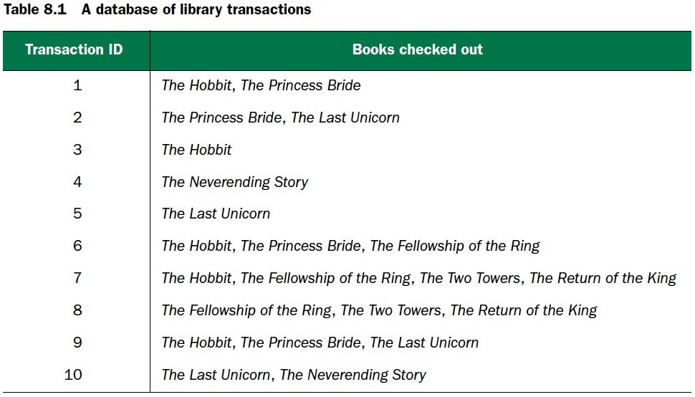
Practical Data Science with R by Nina Zumel, John Mount

Slide 82
Support
T : your database of transactions
support(X)
# of transactions that contain X / total # of transactions in T
Practical Data Science with R by Nina Zumel, John Mount

Slide 83
Confidence
if X, then Y
every time you see the item set X in a transaction, you expect to also see Y
conf(X=>Y)
support(union(X,Y))/support(X)
Practical Data Science with R by Nina Zumel, John Mount

Slide 84
3/10
support of the itemset { The Hobbit, The Princess Bride} =
3/5
confidence : “People who check out The Hobbit also check out The Princess Bride” =
3/4
confidence : “People who check out The Princess Bride also check out The Hobbit ” =
Practical Data Science with R by Nina Zumel, John Mount

Slide 85
The goal in association rule mining
find all the interesting rules in the database with
at least a given minimum support: support(X) > 10%
a minimum given confidence: conf(X=>Y) > 60%
Practical Data Science with R by Nina Zumel, John Mount

Slide 86
Book data
collected in 2004 from the book community Book-Crossing5 for research conducted at the Institut für Informatik, University of Freiburg.
books/book.R
Reading in the book data
library(arules)
bookbaskets <- read.transactions("bookdata.tsv.gz", format="single",
sep="\t",
cols=c("userid", "title"),
rm.duplicates=T,
Header=T)
Practical Data Science with R by Nina Zumel, John Mount

Slide 87
Examining the transaction data
class(bookbaskets)
bookbaskets
dim(bookbaskets)
colnames(bookbaskets)[1:5]
rownames(bookbaskets)[1:5]
#the distribution of transaction sizes
basketSizes <- size(bookbaskets)
summary(basketSizes)
Practical Data Science with R by Nina Zumel, John Mount

Slide 88
Examining data
quantile(basketSizes, probs=seq(0,1,0.1))
library(ggplot2)
ggplot(data.frame(count=basketSizes))+ geom_density(aes(x=count), binwidth=1)+ scale_x_log10()
Practical Data Science with R by Nina Zumel, John Mount

Slide 89
Frequent books
bookFreq <- itemFrequency(bookbaskets)
sum(bookFreq)
bookCount <- (bookFreq/sum(bookFreq))*sum(basketSizes)
summary(bookCount)
orderedBooks <- sort(bookCount, decreasing=T)
orderedBooks[1:10]
orderedBooks[1]/dim(bookbaskets)[1]
Practical Data Science with R by Nina Zumel, John Mount

Slide 90
Finding the association rules
Preprocessing
bookbaskets_use <- bookbaskets[basketSizes > 1]
dim(bookbaskets_use)
Practical Data Science with R by Nina Zumel, John Mount

Slide 91
Finding the association rules
Decide support & confidence
supported by at least 100 people : 100/dim(bookbaskets_use)[1]
confidence : 75%
rules <- apriori(bookbaskets_use, parameter =list(support = 0.002, confidence=0.75))
summary(rules)
Practical Data Science with R by Nina Zumel, John Mount

Slide 92
Scoring rules
measures <- interestMeasure(rules,
measure=c("coverage", "fishersExactTest"),
transactions=bookbaskets_use)
coverage: the support of the left side of the rule (X)
fishersExactTest: a significance test for whether an observed pattern is real, or chance (the same thing lift measures; Fisher’s test is more formal)
Lift = support(union(X, Y))/(support(X)*support(Y))
Practical Data Science with R by Nina Zumel, John Mount

Slide 93
The five most confident rules discovered in the data
inspect(head((sort(rules, by="confidence")), n=5))

Slide 94
Finding rules with restrictions
brules <- apriori(bookbaskets_use,
parameter =list(support = 0.001, confidence=0.6),
appearance=list(rhs=c("The Lovely Bones: A Novel"),
default="lhs"))
summary(brules)
inspect(head(lhs(brules), n=5))
Practical Data Science with R by Nina Zumel, John Mount

Slide 95
Finding rules with restrictions
Inspecting rules
brulesConf <- sort(brules, by="confidence")
inspect(head(lhs(brulesConf), n=5))
Inspecting rules with restrictions
brulesSub <- subset(brules, subset=!(lhs %in% "Lucky : A Memoir"))
brulesConf <- sort(brulesSub, by="confidence")
inspect(head(lhs(brulesConf), n=5))
Practical Data Science with R by Nina Zumel, John Mount

Slide 96
Association rule takeaways
The goal of association rule mining is to find relationships in the data: items or attributes that tend to occur together.
A good rule “if X, then Y” should occur more often than you’d expect to observe by chance.
You can use lift or Fisher’s exact test to check if this is true.
Practical Data Science with R by Nina Zumel, John Mount

Slide 97
Association rule takeaways
When a large number of different possible items can be in a basket (in our example, thousands of different books), most events will be rare (have low support).
Association rule mining is often interactive, as there can be many rules to sort and sift through
Practical Data Science with R by Nina Zumel, John Mount

Slide 98
Takeaways
Unsupervised methods find structure in the data, often as a prelude to predictive modeling.
The goal of clustering is to discover or draw out similarities among subsets of your data.
Practical Data Science with R by Nina Zumel, John Mount

Slide 99
Takeaways
When clustering, you’ll find that scaling is important.
The goal of association rule mining is to find relationships in the data: items or attributes that tend to occur together.
In association rule mining, most events will be rare, so support and confidence levels must often be set low.
Practical Data Science with R by Nina Zumel, John Mount

Slide 100


Thank You Any Question?

